Slide 1
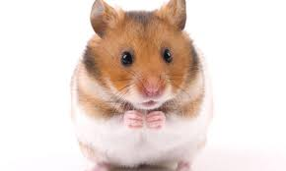
Animal Cannibals – by Anne McMahon
Chorus:
C G
They’re animal cannibals
C G
Animal cannibals
C G D
Animal cannibals – Yeah
C G
They’re animal cannibals
C G
Animal cannibals
C G D G
Animal cannibals – Yeah – OH YEAH
Intro: C G D x2 D
Verse 1:
C G D
What do you eat for breakfast?
C G D
What do you like to drink?
C G D
Some animals eat each other
C G D D
It’s more common than you’d think

Slide 2
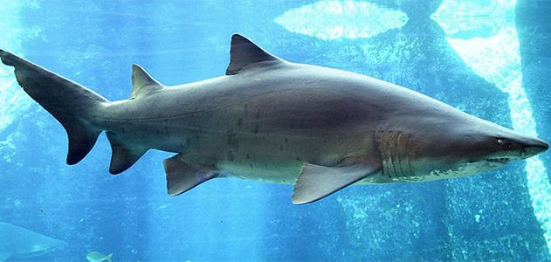
Chorus:
C G
They’re animal cannibals
C G
Animal cannibals
C G D
Animal cannibals – Yeah
C G
They’re animal cannibals
C G
Animal cannibals
C G D G
Animal cannibals – Yeah – OH YEAH
Verse 2:
C G D
In the animal kingdom
C G D
The strongest will survive
C G D
But it’s not very pleasant
C G D D
To be eaten by your parents
(I’m looking at you hamsters)
Verse 3:
C G D
The sand tiger hatchlings
C G D
Don’t even wait to be born
C G D
They chow down on their brothers
C G D D
Because they want to be strong

Slide 3
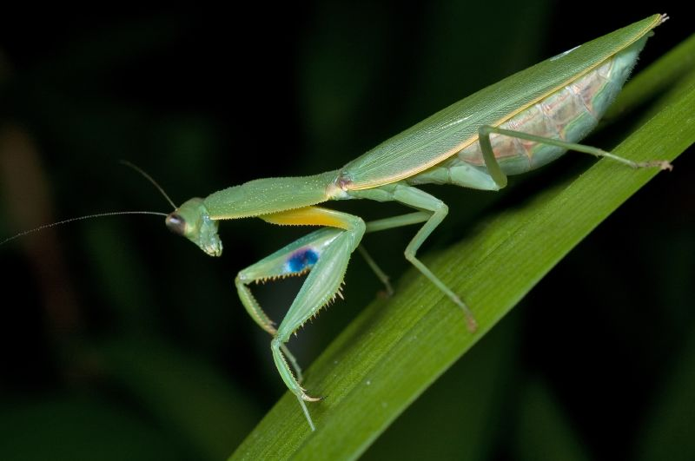
V4:
C G D
There are plenty of spiders
C G D
And lots of insects too
C G D
That eat their mates in a frenzy
C G D D
They needed something to chew
Bridge:
Em D G
Down here in New Zealand
Em D G
Things are done a different way
Em D G C
Our very own praying manitis
Em D G
Doesn’t eat her mate
Em D G
She lets him get away
Chorus:
C G
They’re animal cannibals
C G
Animal cannibals
C G D
Animal cannibals – Yeah
C G
They’re animal cannibals
C G
Animal cannibals
C G D G
Animal cannibals – Yeah – OH YEAH

